Slide 1
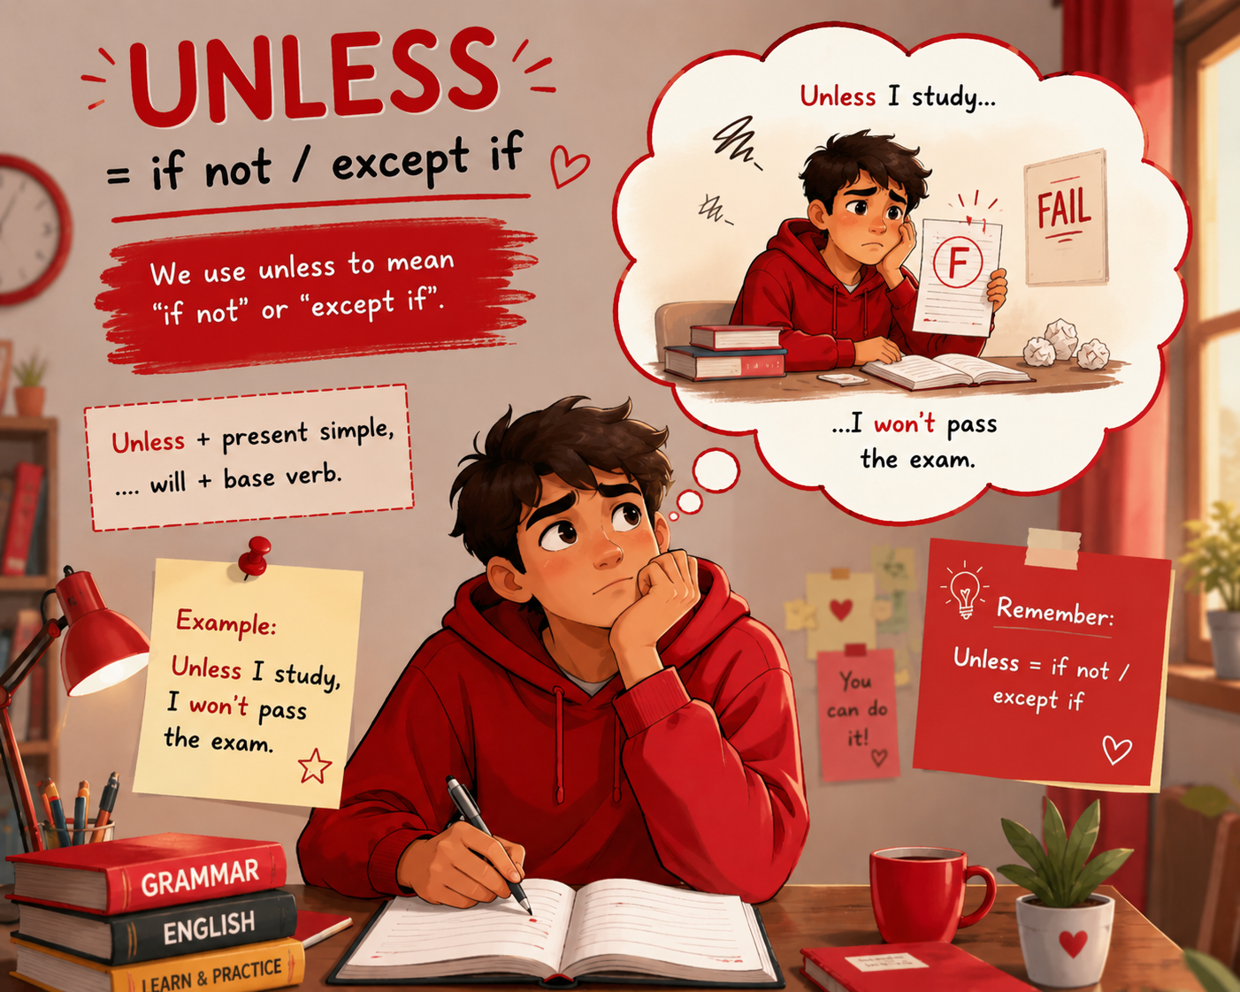

Slide 2
UNLESS (= if not / except if)
Structure: Unless + Present Simple, will/can/may + Verb
  Unless I phone you, you can assume the train is on time. = If I don’t phone…
  We’ll cancel the show unless we sell more tickets. = If we don’t sell more…
  You will fail unless you study. = If you don’t study…
Important rules
❌ Don’t use “unless” for impossible past conditions
❌ Don’t combine “unless + if”
  Unless the government had raised prices...
  If the government had not raised prices...

Slide 3
SHOULD + SUBJECT (formal conditional)
Meaning - Very formal way of saying: “If something happens (maybe unlikely)…”
Structure: Should + Subject + Verb, main clause
Should you wish to cancel your order, contact us. = If you wish to cancel…
Should your child become anxious, inform the teacher. = If your child becomes…
Usage – formal letters | rules and instructions | official documents

Slide 4
HAD + SUBJECT (third conditional inversion)
Meaning - Used instead of: If + Past Perfect
Structure: Had + Subject + V3, would have + V3
Had I known you were waiting, I would have helped. = If I had known…
Had she studied harder, she would have passed. = If she had studied…

Slide 5
As long as / so long as / provided that / on condition that
Meaning - These express: strong conditions / limits
Structure: Main clause + as long as + condition
You can play as long as you don’t make noise.
You can go out provided that you finish your homework.
The bank gave money on condition that it was repaid.

Slide 6
AS LONG AS = SO LONG AS
Ma'nosi: agar, faqat shunda, ... ekan
As long as + Present Simple, will/can/may + Verb
Main clause + as long as + Present Simple
You can borrow my car as long as you drive carefully.
→ Mashinamni olishingiz mumkin, agar ehtiyotkor haydasangizgina.
As long as it doesn't rain, we'll play football.
I don't mind where we go so long as we get home before midnight.

Slide 7
Provided (that) | providing
Ma'nosi: sharti bilan, agar - Bu biroz rasmiyroq.
You can stay here provided (that) you keep quiet.
→ Bu yerda qolishingiz mumkin, jim tursangizgina.
We'll give you a refund providing you have the receipt.
→ Pulingizni qaytaramiz, chekingiz bo‘lsagina.

Slide 8
ON CONDITION THAT
Ma'nosi: ... sharti bilan - Eng rasmiy variantlardan biri.
I will lend you the money on condition that you pay it back next week.
→ Pulni beraman, kelasi hafta qaytarishingiz sharti bilan.
The company agreed to hire him on condition that he completed the training.
→ Kompaniya uni ishga olishga rozi bo‘ldi, treningni tugatishi sharti bilan.

Slide 9
Compare with IF
If you study hard, you will pass the exam.
→ Agar qattiq o‘qisang, imtihondan o‘tasan.
As long as you study hard, you will pass the exam.
→ Imtihondan o‘tasan, faqat qattiq o‘qisangina.
Inversion - Bu bog‘lovchilar odatda inversion qilinmaydi.
You can go out provided that you finish your homework.
Provided that finish your homework, can you go out. (wrong)

Slide 10
OR (= if not)
OR and OTHERWISE - Or va otherwise ko‘pincha if not ("agar bo‘lmasa", "aks holda") ma'nosida ishlatiladi.
Imperative/clause, or + result
You've got to start studying, or you'll fail all those exams.
= If you don't start studying, you'll fail all those exams.
Hurry up, or we'll miss the bus.
= If we don't hurry up, we'll miss the bus.
Wear a coat, or you'll get cold.
= If you don't wear a coat, you'll get cold.

Slide 11
OTHERWISE (= if not)
Formula: Statement/Command + otherwise + result
We'd better send it express; otherwise, it'll take days.
=If we don't send it express, it'll take days.
Study hard; otherwise, you'll fail.
=If you don't study hard, you'll fail.
Leave now; otherwise, we'll be late.
=If we don't leave now, we'll be late.

Slide 12
OR vs OTHERWISE
OR - Ko‘proq buyruq yoki maslahatdan keyin ishlatiladi.
Hurry up, or we'll miss the bus.
Study harder, or you'll fail.
OTHERWISE - Ko‘proq rasmiyroq va yozma uslubda uchraydi.
We must leave now; otherwise, we'll be late.
Submit the form today; otherwise, your application will be rejected.

